Slide 1
OOP (Java)
1. Background
Objectives
  give a non-technical overview of Java

Slide 2

Contents
1. Java, etc.
2. Java's Advantages
3. Java's Disadvantages
4. Some History
5. Types of Java Code
6. Java Safety
7. Core Libraries
8. Notes on Java Installation

Slide 3
1. Java's Many Names
JRE
(Java Runtime
Environment)
tools
runtime;
libraries;
compiler;
profiler;
debugger;
...
language
(Java)
JDK
(Java Software
Development
Kit)
or SDK, JSDK,
J2SDK
Java SE
(current version is 14)
https://jdk.java.net/14/
Notes:
JRE ไม่มีแล้ว เพราะเดี๋ยวนี้พัฒนาจน JDK มีขนาดเล็กพอ ๆ กับ JRE แล้ว จึงไม่มี JRE อีก ตั้งแต่เวอร์ชัน Java 9

Slide 4
Other Javas (e.g. OpenJDK)
I'll be using the Java developed by Oracle (initially by Sun).
There are other implementations of Java, the most important being OpenJDK
  popular on Linux
It's easier for non-Oracle people to add features to OpenJDK.
Notes:
OpenJDK เกิดจากความพยายามของ Sun ที่จะทำให้ Java เป็น Open Source

Slide 5
2. Java’s Advantages
Productivity
  object orientation
  many standard libraries (packages)
Simpler/safer than C, C++
  no pointer arithmetic, has automatic garbage collection, has array bounds checking, etc.
continued

Slide 6

GUI features
  mostly located in the Swing and Abstract Windowing Toolkit (AWT), JavaFX packages
Multimedia
  2D and 3D graphics, imaging, animations, audio, video, etc.
continued

Slide 7
Network support
  communication with other machines/apps
  variety and standards:
    sockets, RMI, IPv6
  security, resource protection
Multithreading / concurrency
  can run several ‘threads’ at once
  extensive concurrency libraries
continued

Slide 8

Portablility / Platform Independence
  “write once; run anywhere”
  only one set of libraries to learn
Supports native code
  can integrate legacy (old) C/C++ code
JDK is free
continued

Slide 9
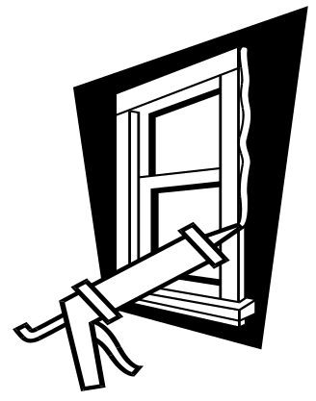
Good programming environments:
  Eclipse, IntelliJ, NetBeans
  do not use them when first learning Java
Applets (and Java Web Start) eliminates the need for explicit software installation.
Notes:
Java Web Start ถูกประกาศเลิกใช้ตั้งแต่ JDK9 และถูกถอดออกไปตั้งแต่ JDK11

Slide 10
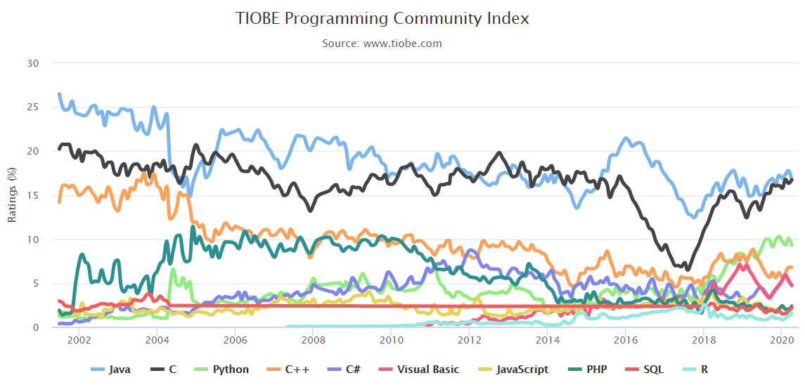
Java Popularrity (April 2020)

Slide 11
3. Java’s Disadvantages
Java/JDK is still being developed
  many changes between versions
Sun has not guaranteed backward compatibility of future versions of Java.
  at the moment, when old-style code is compiled, the compiler gives a “deprecation” warning, but will still accept it
continued
Notes:
Generic = Java 1.5

Slide 12
Java compilation/execution was slow, but...
  not any more: JDK 8 is the same speed as C (perhaps a tiny bit slower for some things)
  there are compilers to native code, but they destroy the “write one; run anywhere” idea
  the first version of Java, back in 1995, was about 40 times slower than C
continued

Slide 13
Cross-platform testing and debugging has been a problem (due to inconsistencies)
  most major problems have been fixed
“Write once; run anywhere” means that some local OS features weren't supported:
  e.g. right button actions under Windows
  no joysticks, special keypads
  this is fixed in the latest versions of Java
continued

Slide 14

Java’s security restrictions makes some code hard to write:
  cannot “see” much of a local machine
  newer JDK versions make this easier
The existing code base (in C, VB, etc.) means that people do not want to rewrite applications in Java.
continued

Slide 15

Embedded Systems
  Sun Microsystems (Java’s inventor) saw this as a major market for Java
  Java ME (Java 2 Micro Edition) is a cut-down version of Java
  Java ME was the main programming language for mobile devices
continued

Slide 16

Slow Internet connections
  makes it difficult (and irritating) to download medium/large size applets
  e.g. flash files have replaced Java animations
Lots to learn
  Java language (small) and Java libraries
  (very, very large)
continued

Slide 17

4. Some History
In 1991, Sun Microsystems set up a research project to develop a language for programming ‘intelligent’ consumer electronics
  e.g. video recorders, TVs, toasters
The language was called Oak (later changed to Java). Developed by James Gosling, and others.
Notes:
Duke เป็น Oak’s Smart Agent ตอนหลังเปลี่ยนชื่อเพราะชื่อซ้ำกับ Oak Technology ในปี 1996

Slide 18
August 1993: the project was cancelled after two commercial deals fell through.
The Web became popular during 1993.
July 1994: Sun restarted work on Java as a Web programming language
  Java contains networking features, platform portability, and a small runtime system
continued

Slide 19
Java released May 1995
  Netscape supported Java in Navigator 2.0, which gave it an enormous boost
May 1996: JDK 1.0 released
  hurried library development; mistakes made
February 1997: JDK 1.1 released
  major changes in the event model used by the GUI; inner classes introduced
continued

Slide 20
December 1998: JDK 1.2 released
  also known as Java 2
  much improved GUIs (Swing), graphics
September 2000: J2SDK 1.3 released
  still known as Java 2
  improved networking, sound, security
continued

Slide 21
February 2002: J2SE 1.4 released
  still known as Java 2
  improved I/O, GUI improvements, increase in standard libraries (62% more classes!)

Slide 22
September 2004: J2SE 1.5 released
  also known as J2SE 5.0
  the language is still Java 2
  new stuff: easy IO, generics, enumerated types, autoboxing, concurrency tools, faster speed, improved monitoring/profiling/debugging

Slide 23
Java SE 6.0, 2006
Splashscreens, desktop API, translucency
More diagnostics, monitoring
XML and Web Services
Rhino JavaScript engine in Java

Slide 24
Oracle buys Sun in April 2009
  no change to Java/JDK except for rebranding
  some URL changes

Slide 25
Java SE 7, 2011
Strings in switch/case statement
Binary integers; underscores in numbers
Resource management in try-catch blocks
Multiple exceptions
Diamond operator
New file APIs

Slide 26
Java 2D rendering using GPUs
Swing JLayer component
New concurrency utilities
  Fork/Join
  distribute tasks across multiple cores, then join result parts to create a single result
continued

Slide 27
Java SE 8, 2015
Lambda expressions and closures
  functional programming
  for programming multi-core CPUs
  parallel calculations of collections
Stream API
Integration with JavaFX 3.0
  will replace Swing eventually

Slide 28
Which Java Should I Use?
The latest version (Jan. 2016) is:
  JDK 8, update 65 (latest), or
  JavaSE 6.0, update 20-22
Textbooks that talk about J2SE 1.5 /
JDK 5.0 are okay for new Java programmers.
Older textbooks should be thrown in a rubbish bin.

Slide 29
5. Types of Java Code
There are two kinds of Java code:
1. Java applications
  ordinary programs; stand-alone
  they don’t run inside a browser
  (but they can use Java’s GUI libraries)
We will see
examples in
the next part.
continued

Slide 30
2. Java applets
  they run in a Web browser
  they are attached to Web pages, so can be downloaded easily from anywhere
  applets have access to browser features

Slide 31

6. Java Safety
6.1. Java Bytecodes
6.2. Applet advantage/disadvantage
6.3. The Java Virtual Machine
6.4. JVM Restrictions upon Applets
6.5. Relaxing Security

Slide 32
6.1. Java Bytecodes
The Java compiler (javac) generates bytecodes
  a set of instructions similar to machine code
  not specific to any machine architecture
A class file (holding bytecodes) can be run on any machine which has a Java runtime environment (JVM).

Slide 33

The Bytecode Advantage
JVM (Windows)
javac (Windows)
compile
JVM (Mac)
run
javac (Mac)
Java code
(.java text
file)
Java bytecode
(.class file)
JVM (Linux)
javac (Linux)

Slide 34
6.2. The Java Virtual Machine
The Java Virtual Machine (JVM) is the Java runtime environment.
  it acts as a layer between the executing byte codes in an applet and the actual machine
  it hides variations between machines
  it protects the machine from attack by the applet/application

Slide 35
Applet Execution with the JVM
applet
applet
download
Web page
and applet
JVM
Web Server
Web Browser
Client Computer

Slide 36
Application Execution with the JVM
The difference is the amount of security imposed by the JVM
  applets are allowed to do a lot less than applications
application
JVM
Client Computer

Slide 37
6.3. JVM Restrictions upon Applets
An applet runs in its own memory space
  it cannot access the local system’s memory
  it cannot interfere with other running apps
An applet cannot read/write to files on the local system (except to special directories).
  e.g. it cannot read system files
continued

Slide 38
An applet cannot easily run local applications
  e.g. system functions, DLLs
An applet can only communicate with its home server
  this restriction is configurable on the client-side

Slide 39

6.4. Relaxing Security
Applets can be signed with trusted certificates
  a browser can be configured to relax security depending on an applet’s signature
  an advanced topic

Slide 40

7. Core Libraries
Java runtime
  standard I/O, networking, applets, basic windowing, data structures, internationalization, maths, etc.
Java Foundation Classes
  Swing GUI library, Java 2D graphics
continued

Slide 41
Security
  digital signatures, message digests
JDBC
  database connectivity
Java RMI
  remote method invocation
JavaBeans
  a software component library
and much, much more…

Slide 42
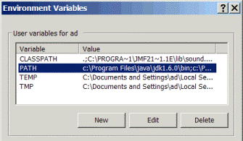
8. Notes on Java Installation
Add the bin path for Java to the PATH environment variable
This says where
the Java tools
(e.g. javac) are
located.
c:\Program Files\java\jdk1.6.0_22\bin;

Slide 43
Install the Java Docs/Tutorial
Unzip the Java documentation and tutorial files:
  jdk-6-doc.zip
  tutorial.zip
Place them as subdirectories \docs and \tutorial below the directory java
continued

Slide 44
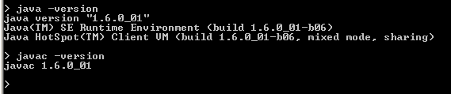
You should add a Java menu item to the “Start” menu, which contains shortcut links to the Java documentation and tutorial.
Test the Java. In a DOS window, type:
  > java –version
  > javac -version

